Slide 1
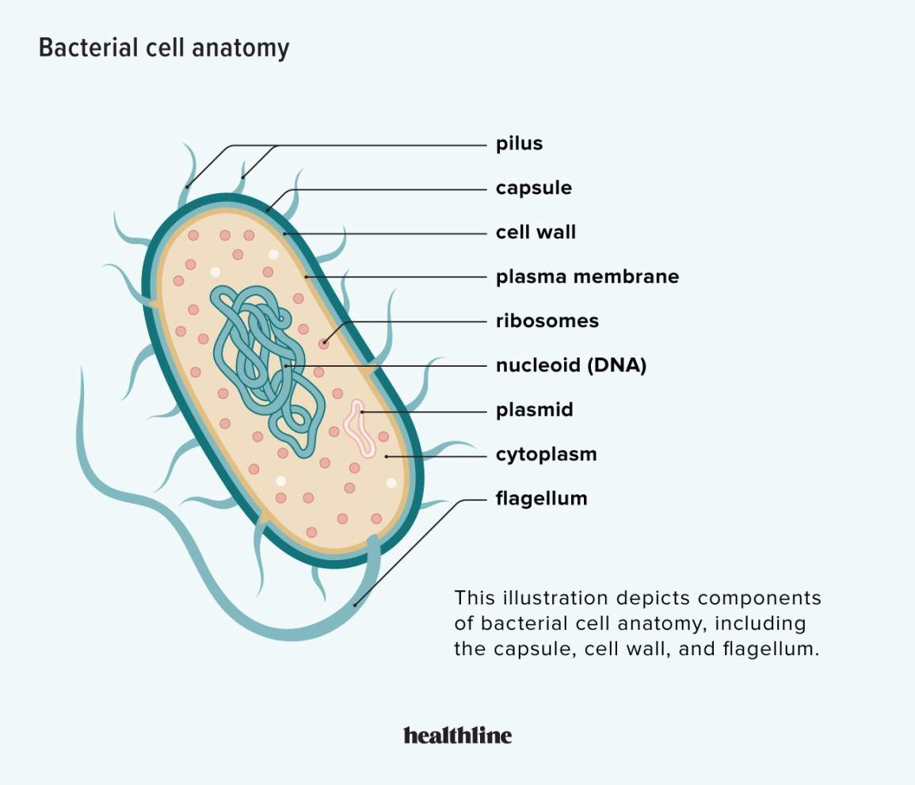
Bacteria
How it spreads disease:
Can be spread by person-to-person contact, in water droplets breathed in from the air, through infected food and through touching infected surfaces.
Examples:
Bacterial meningitis
Cholera
Diphtheria
Tuberculosis
Typhoid
Notes:
CFU – read through the slide, have students look closely at the diagram, then allow think time, before asking them to explain it to their partner using the key terms pure substance and mixture. Call on non-volunteers and provide feedback, encouraging detailed responses in full sentence form.

Slide 2
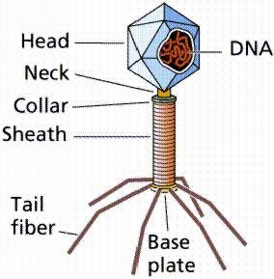
How it spreads disease?
3 main ways:
1. Person to person:
Viruses that cannot survive for long outside of the host. Travel in body fluids E.g., HIV
2. Environment to person: Viruses that can survive outside of body. E.g., Rhinovirus (the common cold) Can survive for about two days on some surfaces.
3. Animal to person: the least common by far.
Example of viral pathogens include:
Avian Flu Chicken pox
Colds
Ross River Virus
Rubella
Virus

Slide 3
Mode of transmission: Contact: Direct and indirect
Touching an infected person and then putting your fingers in your mouth. (Direct).
Touching an item that an infected person has touched and then putting mouth. (before washing your hands). (Indirect), from using unwashed plates.
Examples: skin infections like plantar warts, conjunctivitis.

Slide 4
Mode of transmission: Transfer of body fluids
This could be the transfer of infected blood or fluids, like semen or substances produced by mucous membranes, e.g. saliva.
Examples: HIV, glandular fever, hepatitis B and C.

Slide 5
Mode of transmission: Infection by droplets
This is when pathogens are expelled in tiny droplets of moisture from an infected person. This is usually into the air through coughing, breathing, sneezing, but droplets may settle on non-living items, like plates or utensils, which are then placed into food which is ingested.
Examples: Measles, mumps, colds and influenza.

Slide 6
Mode of transmission: Disease-specific vectors
Some pathogens are transmitted from one organism to another by using another animal.
Examples: Malaria, Lyme disease, Ross river virus.

Slide 7
Mode of transmission: Ingestion
Food that is contaminated may not be cooked properly. Therefore, the pathogen has been given ideal conditions to grow and multiply.
Also, some foods are left for too long and this gives time for bacteria in the air to settle in the food and grow.
Examples: Dysentery, Salmonella and typhoid.

Slide 9
Non-specific defenses against disease
Our bodies have several defences that protect us against invasion by pathogenic micro-organisms.
Non-specific defences work against all pathogens. They are the body’s first line of defence.
Specific defences are directed at a particular pathogen.

Slide 10
External defences
The body’s external defences include:
Skin
Mucus
Hairs
Cilia
Acids
Lysozyme
Cerumen
Movement of fluid

Slide 11
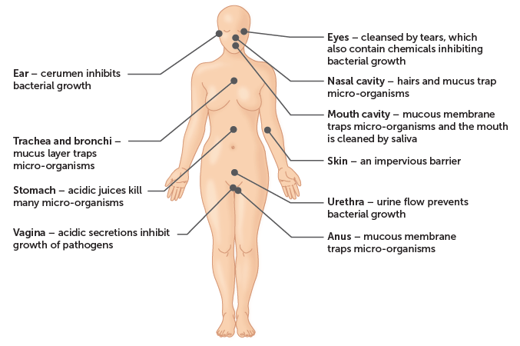

Slide 12
Skin
The skin is an effective barrier covering the outside of the body. It is very good at stopping the entry of micro-organisms, provided it is not broken by cuts and abrasions.
At openings in the skin, such as the mouth, eyes and anus, special protection is provided by other defences.
Huge numbers of bacteria live on the skin all the time. These normal bacteria occupy the area. and so potential pathogens find it difficult to become established.
In addition, the skin has other protective mechanisms. An oily secretion called sebum is produced by oil glands in the skin. It contains substances that kill some pathogenic bacteria. Sweat secreted on to the skin contains salts and fatty acids that prevent the growth of many micro-organisms.

Slide 13
Mucus
Mucous membranes line body cavities that open to the exterior.
They secrete mucus. which traps particles and, therefore, inhibits the entry of micro-organisms to the organs of the body.
The digestive, urinary and reproductive tracts are all protected in this way.

Slide 14
Hairs:
Hairs are found in the nasal cavity in the nose, and in the ears. In the nose, the hairs and a layer of mucus trap up to 90% of particles inhaled when breathing.

Slide 15
Cilia:
Cilia are tiny hair-like projections from cells that are capable of a beating motion.
The mucous membranes lining the nasal cavity, the trachea and other air passages have cilia.
The beating of the cilia moves mucus, containing trapped particles and micro-organisms, towards the throat, where it may be coughed up or swallowed.

Slide 16
Acids
Stomach juices are strongly acidic.
The acid kills many of the bacteria taken in with food or those contained in mucus swallowed from the nose and windpipe.
The vagina also has acid secretions that reduce the growth of micro-organisms.
Urine and the sweat on the skin are also slightly acidic.

Slide 17
Lysozyme
Lysozyme is an enzyme that kills bacteria.
The eyes are protected by the flushing action of tears, which contain this enzyme.
Lysozyme is also found in saliva, sweat, secretions of the nose and tissue fluid.

Slide 18
Cerumen
Cerumen or ear wax, protects the outer ear against infection by some bacteria.
It is slightly acidic and contains lysozyme.

Slide 19
Movement of fluid
The flushing action of body fluids helps to keep some areas relatively free of pathogens.
Urine flowing through the urethra has a cleansing action.
This prevents bacterial growth and helps to stop bacteria reaching the bladder and kidneys.
Women have a shorter urethra than men and so they tend to suffer more bladder infections. Tears, sweat and saliva are also involved in flushing and cleansing.

